Slide 1

Chapter 1
Management Support Systems:
An Overview
Turban, Aronson, and Liang Decision Support Systems and Intelligent Systems, Seventh Edition
Prentice Hall, Decision Support Systems and Intelligent Systems, 7th Edition, Turban, Aronson, and Liang
1-1

Slide 2
Learning Objectives
Understand how management uses computer technologies.
Learn basic concepts of decision-making.
Understands decision support systems.
Recognize different types of decision support systems used in the workplace.
Determine which type of decision support system is applicable in specific situations.
Learn what role the Web has played in the development of these systems.
Prentice Hall, Decision Support Systems and Intelligent Systems, 7th Edition, Turban, Aronson, and Liang
1-<number>

Slide 3
Harrah’s Makes a Great Bet Vignette
Data Warehouse
Data Mining
Business Intelligence
Transaction Processing System
Customer Relationship Management
Decision Support System
Prentice Hall, Decision Support Systems and Intelligent Systems, 7th Edition, Turban, Aronson, and Liang
1-<number>

Slide 4
Mintzberg’s 10 Management Roles
Interpersonal
  Figurehead
  Leader
  Liaison
Informational
  Monitor
  Disseminator
  Spokesperson
Decisional
  Entrepreneur
  Disturbance Handler
  Resource Allocation
  Negotiator
Prentice Hall, Decision Support Systems and Intelligent Systems, 7th Edition, Turban, Aronson, and Liang
1-<number>

Slide 5
Productivity
The ratio of outputs to inputs that measures the degree of success of an organization and its individual parts
© 2005 Prentice Hall, Decision Support Systems and Intelligent Systems, 7th Edition, Turban, Aronson, and Liang
1-<number>

Slide 6
Factors Affecting Decision-Making
New technologies and better information distribution have resulted in more alternatives for management.
Complex operations have increased the costs of errors, causing a chain reaction throughout the organization.
Rapidly changing global economies and markets are producing greater uncertainty and requiring faster response in order to maintain competitive advantages.
Increasing governmental regulation coupled with political destabilization have caused great uncertainty.
© 2005 Prentice Hall, Decision Support Systems and Intelligent Systems, 7th Edition, Turban, Aronson, and Liang
1-<number>

Slide 7
What do Decision Support Systems Offer?
Quick computations at a lower cost
Group collaboration and communication
Increased productivity
Ready access to information stored in multiple databases and data warehouse
Ability to analyze multiple alternatives and apply risk management
Enterprise resource management
Tools to obtain and maintain competitive advantage
© 2005 Prentice Hall, Decision Support Systems and Intelligent Systems, 7th Edition, Turban, Aronson, and Liang
1-<number>

Slide 8
Cognitive Limits
The human mind has limited processing and storage capabilities.
Any single person is therefore limited in their decision making abilities.
Collaboration with others allows for a wider range of possible answers, but will often be faced with communications problems.
Computers improve the coordination of these activities.
This knowledge sharing is enhanced through the use of GSS, KMS, and EIS.
© 2005 Prentice Hall, Decision Support Systems and Intelligent Systems, 7th Edition, Turban, Aronson, and Liang
1-<number>

Slide 9
Management Support Systems
The support of management tasks by the application of technologies
  Sometimes called Decision Support Systems or Business Intelligence
© 2005 Prentice Hall, Decision Support Systems and Intelligent Systems, 7th Edition, Turban, Aronson, and Liang
1-<number>

Slide 10
Management Support Systems Tools
DSS
Management Science
Business Analytics
Data Mining
Data Warehouse
Business Intelligence
OLAP
CASE tools
GSS
EIS
EIP
ERM
ERP
CRM
SCM
KMS
KMP
ES
ANN
Intelligent Agents
E-commerce DSS
© 2005 Prentice Hall, Decision Support Systems and Intelligent Systems, 7th Edition, Turban, Aronson, and Liang
1-<number>

Slide 11
Decision Support Frameworks
 | Type of Control
Type of Decision: | Operational Control | Managerial Control | Strategic Planning
Structured (Programmed) | Accounts receivable, accounts payable, order entry | Budget analysis, short-term forecasting, personnel reports | Investments, warehouse locations, distribution centers
Semistructured | Production scheduling, inventory control | Credit evaluation, budget preparation, project scheduling, rewards systems | Mergers and acquisitions, new product planning, compensation, QA, HR policy planning
Unstructured (Unprogrammed) | Buying software, approving loans, help desk | Negotiations, recruitment, hardware purchasing | R&D planning, technology development, social responsibility plans
© 2005 Prentice Hall, Decision Support Systems and Intelligent Systems, 7th Edition, Turban, Aronson, and Liang
1-<number>

Slide 12
Technologies for Decision-Making Processes
Type of Decision | Technology Support Needed
Structured (Programmed) | MIS, Management Science Models, Transaction Processing
Semistructured | DSS, KMS, GSS, CRM, SCM
Unstructured (Unprogrammed) | GSS, KMS, ES, Neural networks
© 2005 Prentice Hall, Decision Support Systems and Intelligent Systems, 7th Edition, Turban, Aronson, and Liang
1-<number>

Slide 13
Technology Support Based on Anthony’s Taxonomy
 | Type of Control
 | Operational Control | Managerial Control | Strategic Planning
Technology Support Needed | MIS, Management Science | Management Science, DSS, ES, EIS, SCM, CRM, GSS, SCM | GSS, CRM, EIS, ES, neural networks, KMS
© 2005 Prentice Hall, Decision Support Systems and Intelligent Systems, 7th Edition, Turban, Aronson, and Liang
1-<number>

Slide 14
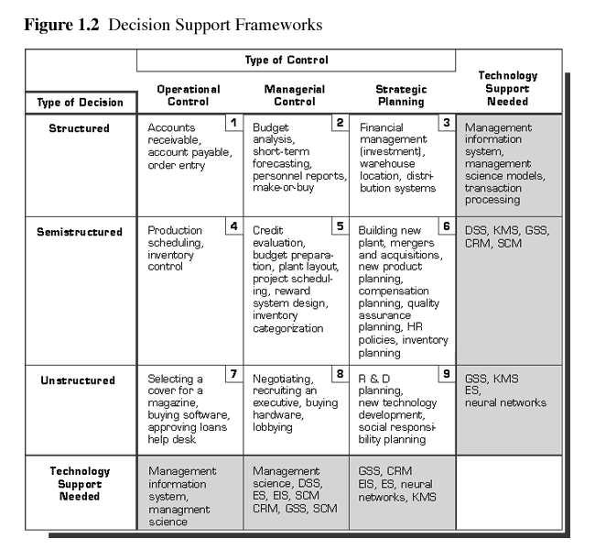
© 2005 Prentice Hall, Decision Support Systems and Intelligent Systems, 7th Edition, Turban, Aronson, and Liang
1-<number>

Slide 15
Management Science/Operations Research
Adopts systematic approach
  Define problem
  Classify into standard category
  Construct mathematical model
  Evaluate alternative solutions
  Select solution
© 2005 Prentice Hall, Decision Support Systems and Intelligent Systems, 7th Edition, Turban, Aronson, and Liang
1-<number>

Slide 16
Enterprise Information Systems
Evolved from Executive Information Systems combined with Web technologies
EIPs view information across entire organizations
Provide rapid access to detailed information through drill-down.
Provide user-friendly interfaces through portals.
Identifies opportunities and threats
© 2005 Prentice Hall, Decision Support Systems and Intelligent Systems, 7th Edition, Turban, Aronson, and Liang
1-<number>

Slide 17
Enterprise Information Systems
Specialized systems include ERM, ERP, CRM, and SCM
Provides timely and effective corporate level tracking and control.
Filter, compress, and track critical data and information.
© 2005 Prentice Hall, Decision Support Systems and Intelligent Systems, 7th Edition, Turban, Aronson, and Liang
1-<number>

Slide 18
Knowledge Management Systems
Knowledge that is organized and stored in a repository for use by an organization
Can be used to solve similar or identical problems in the future
ROIs as high as a factor of 25 within one to two years
© 2005 Prentice Hall, Decision Support Systems and Intelligent Systems, 7th Edition, Turban, Aronson, and Liang
1-<number>

Slide 19
Expert Systems
Technologies that apply reasoning methodologies in a specific domain
Attempts to mimic human experts’ problem solving
Examples include:
  Artificial Intelligence Systems
  Artificial Neural Networks (neural computing)
  Genetic Algorithms
  Fuzzy Logic
  Intelligent Agents
© 2005 Prentice Hall, Decision Support Systems and Intelligent Systems, 7th Edition, Turban, Aronson, and Liang
1-<number>

Slide 20
Hybrid Support Systems
Integration of different computer system tools to resolve problems
Tools perform different tasks, but support each other
Together, produce more sophisticated answers
Work together to produce smarter answers
© 2005 Prentice Hall, Decision Support Systems and Intelligent Systems, 7th Edition, Turban, Aronson, and Liang
1-<number>

Slide 21
Emerging Technologies
Grid computing
Improved GUIs
Model-driven architectures with code reuse
M-based and L-based wireless computing
Intelligent agents
Genetic algorithms
Heuristics and new problem-solving techniques
Prentice Hall, Decision Support Systems and Intelligent Systems, 7th Edition, Turban, Aronson, and Liang
1-<number>

